Slide 1
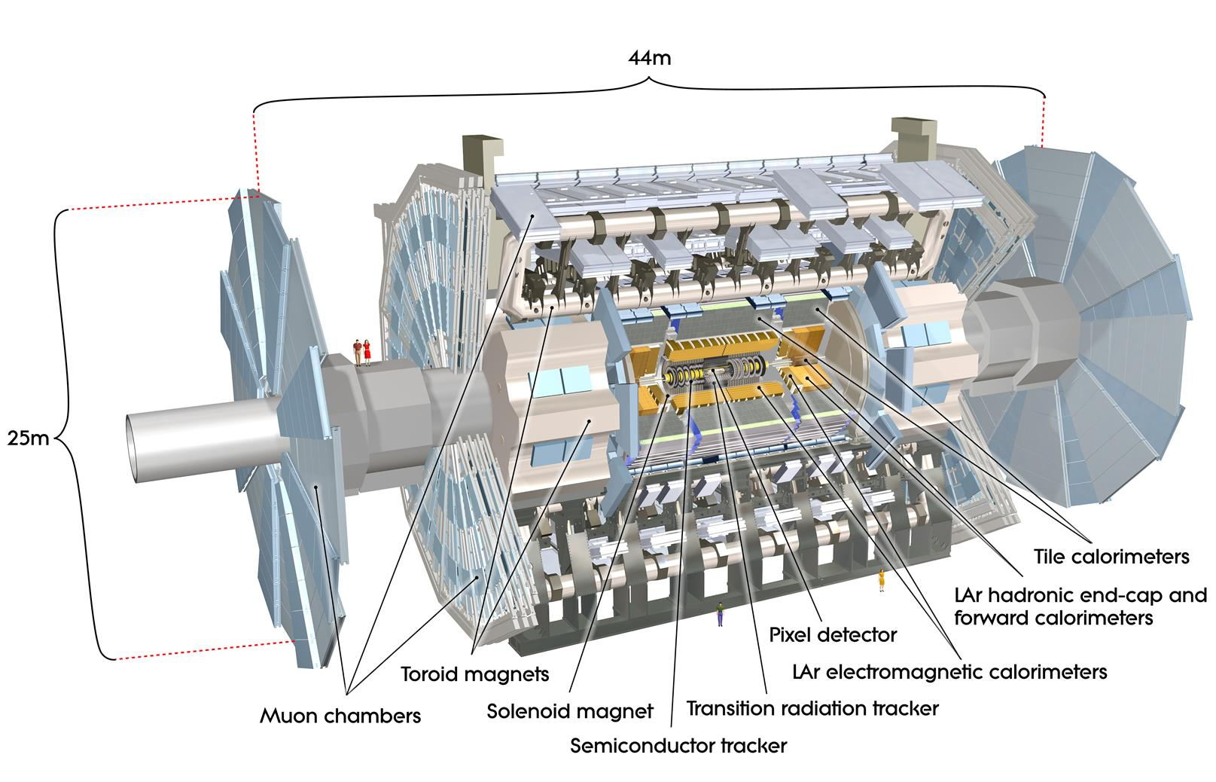


Quantum Hough Transform
for Charged-Particle Track Reconstruction 02-21-2020
Amitabh Yadav (amitabhyadav@lbl.gov) Heather Gray HEP Quantum Pattern Recognition - https://hep-qpr.lbl.gov/
Lawrence Berkeley National Laboratory

Slide 2
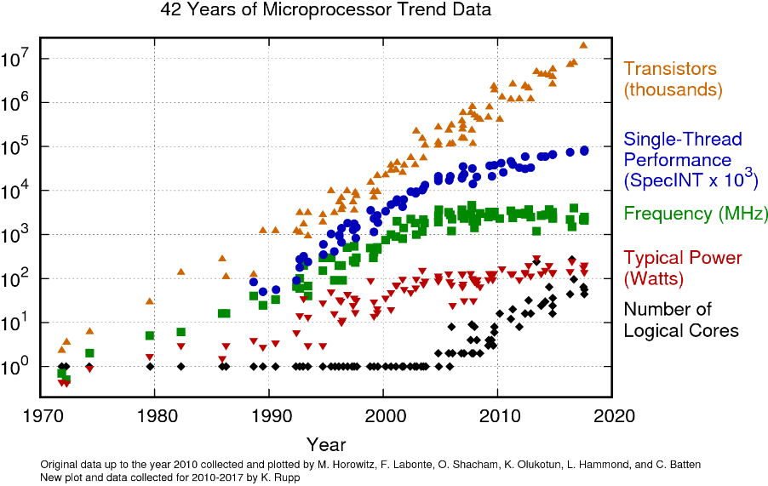
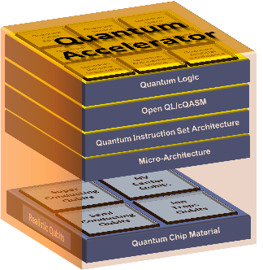
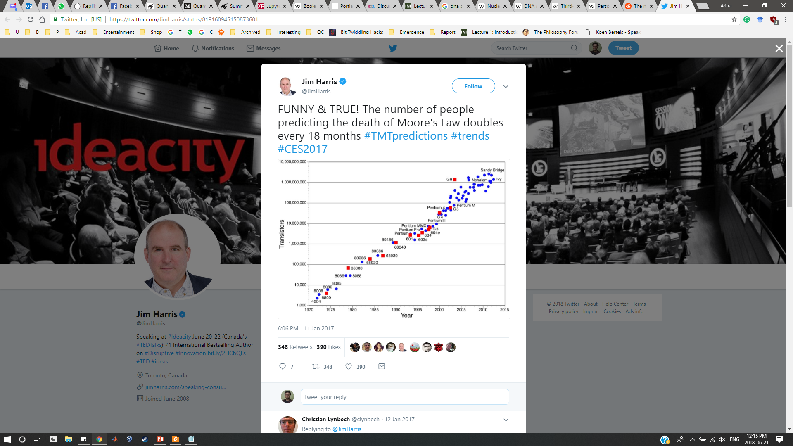
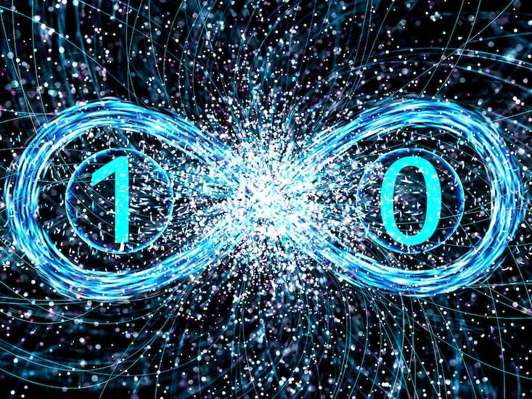
The Perspective
Graphics Processing Unit
Field-Programmable Gate Array
Digital Signal Processor
Neural Processing Unit
map problem to quantum:
do:
run Q Algorithm
Host CPU
Quantum Accelerator
Classical data encoding in quantum states
save measurement result/statistics
interpret classical measurement
+
Notes:
Motivation: First and Second Quantum Revolution (JP Dowling’s Paper)
Present Day applications (Chemistry/Physics Simulation, Optimization, ML...)
Modern Methods used in QC - the landscape

Slide 3
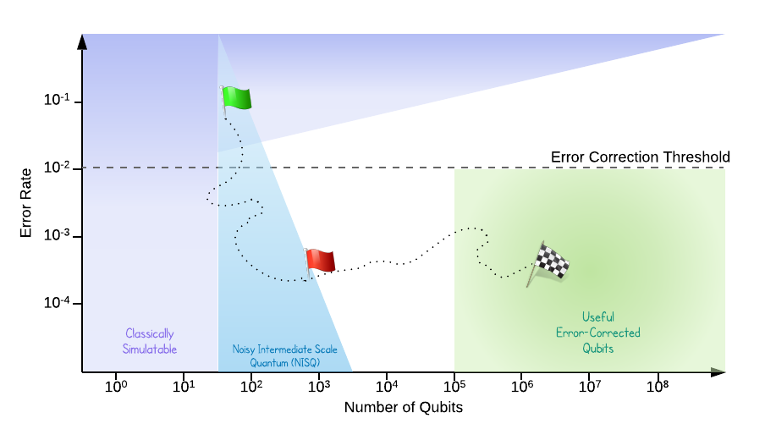
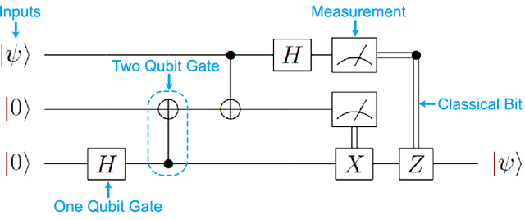
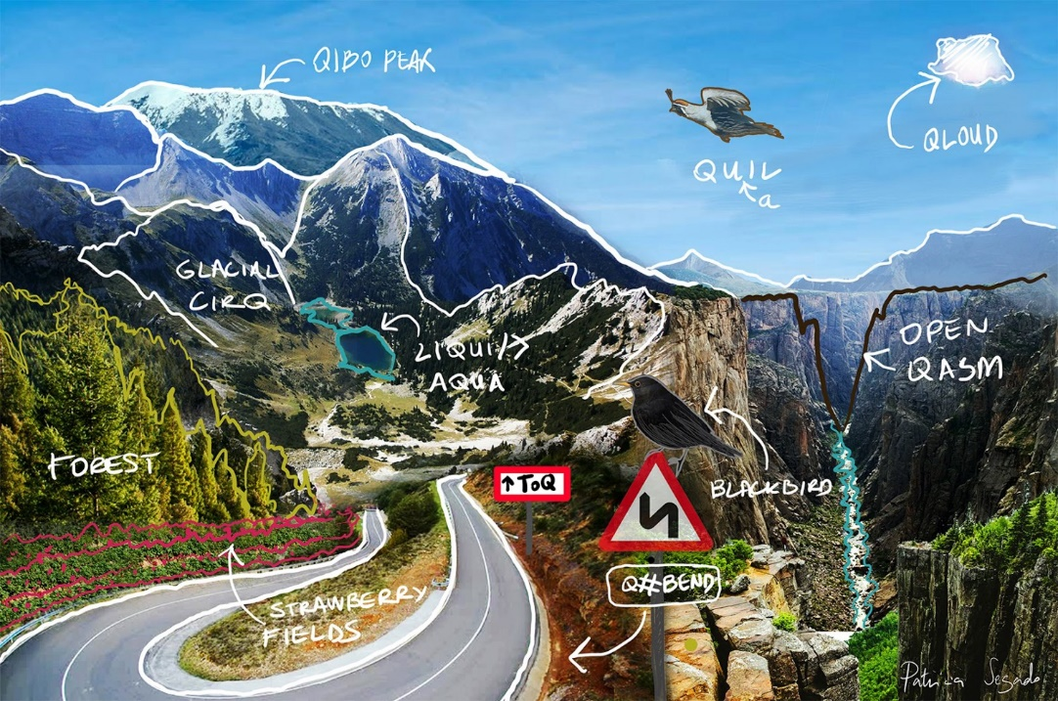
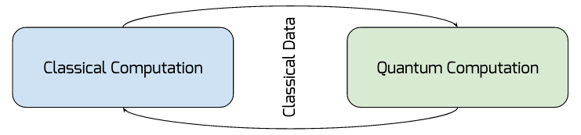
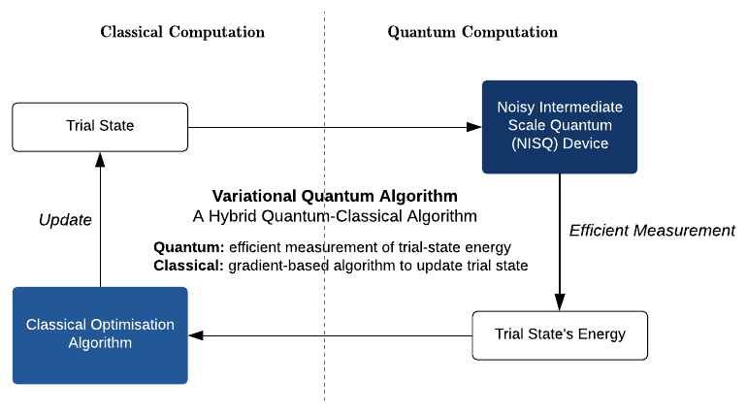
The Idea
𝖡𝖰𝖯 ⊆ 𝖯𝖲𝖯𝖠𝖢𝖤
Circuit Model QC
Solovay-Kitaev Theorem
Universal Quantum Computing
Quantum Computing Applications Approach
Perfect Qubits
Erroneous Qubits in NISQ-era - Test algorithmic bounds of error-tolerance, - Pauli Frames, - Temporary Quantum Registers and SWAPS, - Small (distance) EC Codes etc.
Ref: https://ai.googleblog.com/2018/03/a-preview-of-bristlecone-googles-new.html
QPU vs Simulators platform
Quantum accelerator model? - Kind of but Not really.
In-memory computing model.
Good QC Packages out there for modern QC methods: (QISKIT, Forest, D-Wave Ocean, Xanadu PennyLane, Entropica, QuEST, quantumSim, Project-Q, QX… to name a few)
Notes:
Motivation: First and Second Quantum Revolution (JP Dowling’s Paper)
Present Day applications (Chemistry/Physics Simulation, Optimization, ML...)
Modern Methods used in QC - the landscape

Slide 4
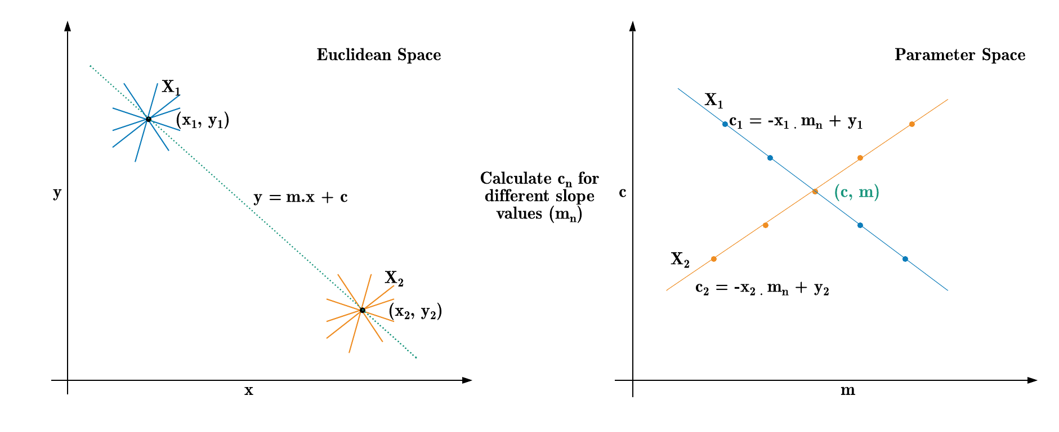

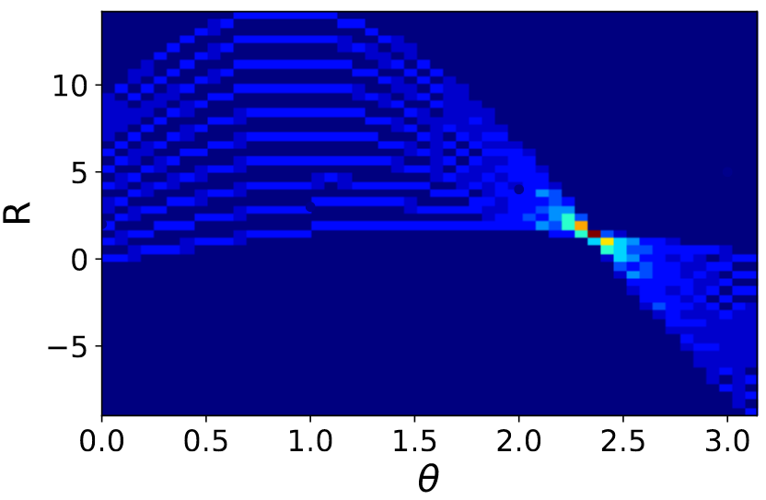
Hough Transform
Feature Extraction Technique commonly used in Image Processing/Computer Vision.
Identification of lines and other shapes such as circles or ellipses.
Used for HEP Tracking Application.
A line is represented as a point (b, m) in parameter space and, (r, θ) in Hough Space.
Hough Space
In the Hough Space, we calculate r for each θ.
All the points on the line are represented by a local maximum.
Notes:
Hough Transform Algorithm flow.
Bottleneck in (classical) Hough Transform?
Quantum Advantage/Rationale? Exponential State Space + Spookiness (aka Entanglement).

Slide 5
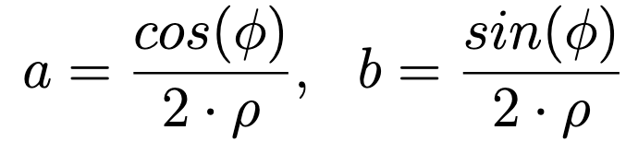
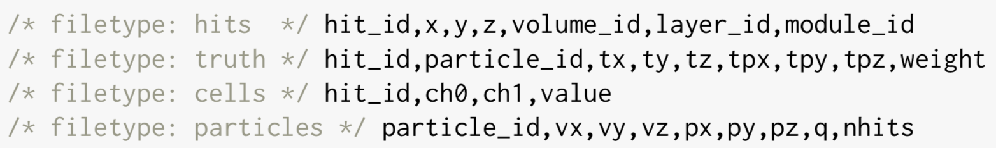
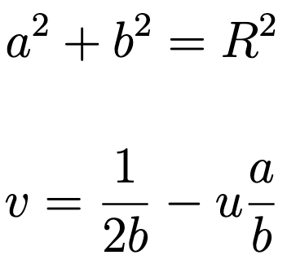
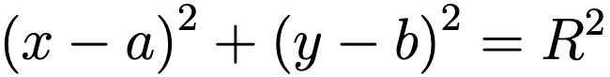
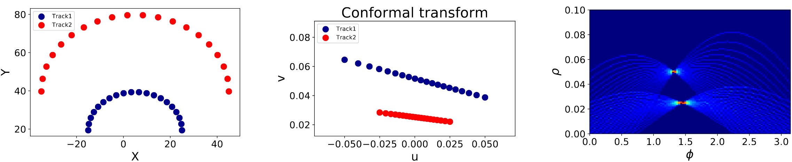
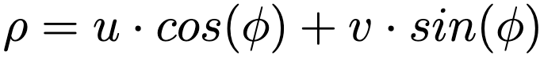
Hough Transform
for Track Reconstruction
The conformal mapping maps a circle to a line if and only if the circle passes from the origin or following the condition:
The center of the circle is extracted from the Hough transformation using
TrackML Dataset
Pattern Recognition is performed by finding the local maxima in the Hough space.
Ref.: Alipour Tehrani, Niloufar “Simulation and tracking studies for a drift chamber at the FCC-ee experiment” (2019). cds.cern.ch
Notes:
2 slides

Slide 6
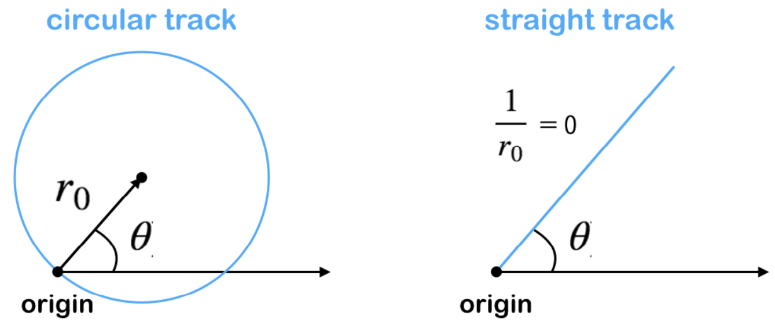
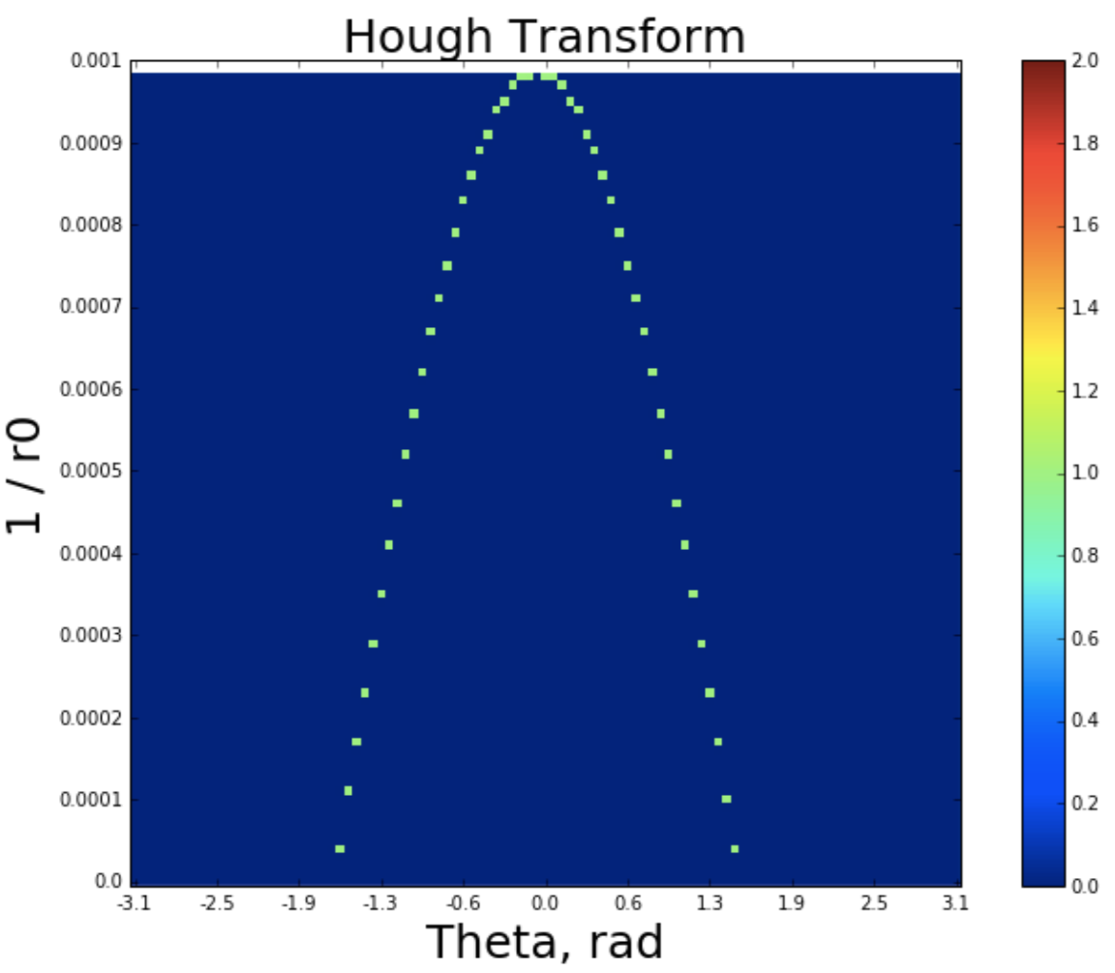
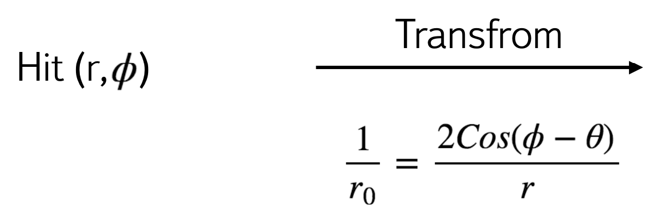
Hough Transform for a Hit
In polar coordinates (r, ϕ)
r = 2r₀ cos(ϕ - θ)
One hit with coordinates (r, ϕ)
Ref.: TrackML particle tracking challenge: https://www.kaggle.com/c/trackml-particle-identification/overview

Slide 7
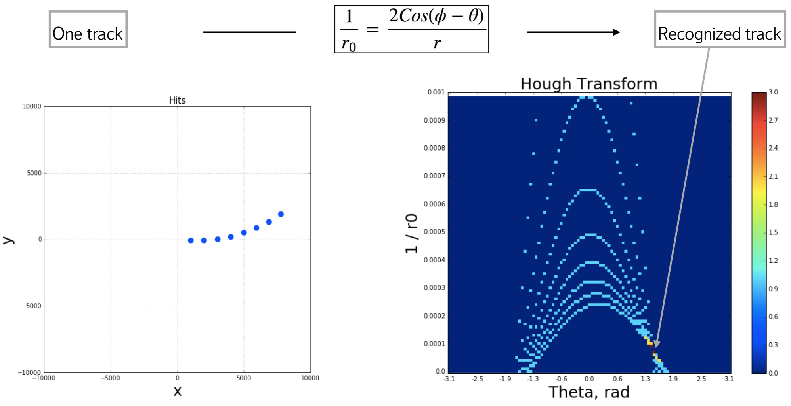
Hough Transform for a Track
Ref.: TrackML particle tracking challenge: https://www.kaggle.com/c/trackml-particle-identification/overview

Slide 8
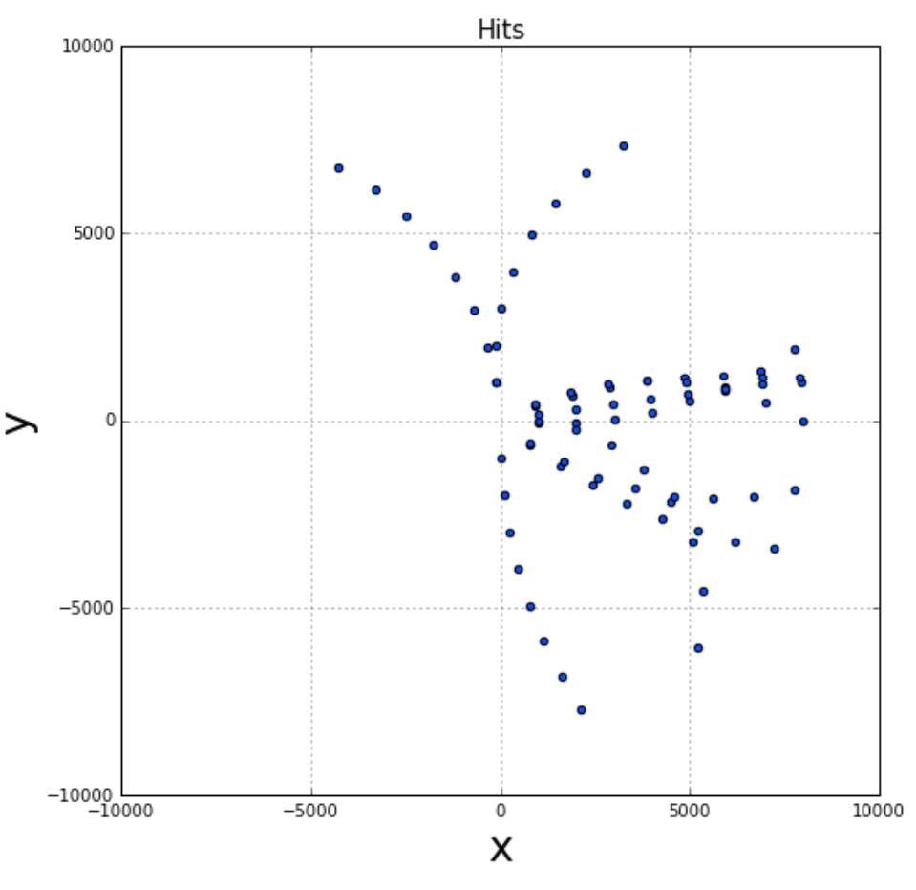
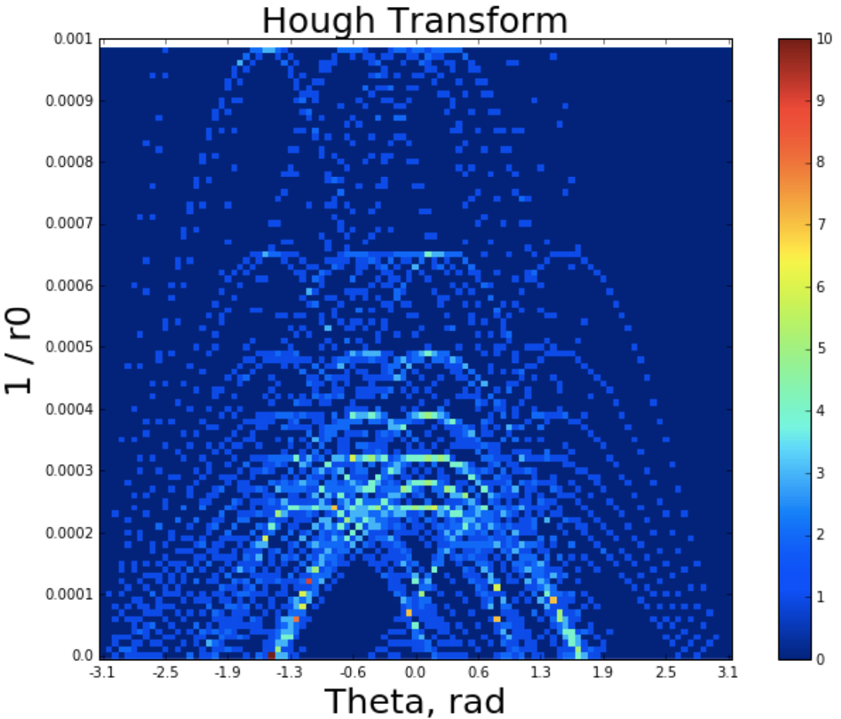
Hough Transform for an Event
Ref.: TrackML particle tracking challenge: https://www.kaggle.com/c/trackml-particle-identification/overview

Slide 9
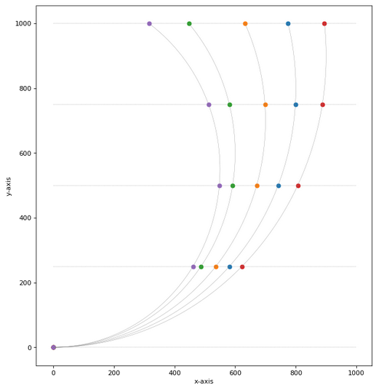
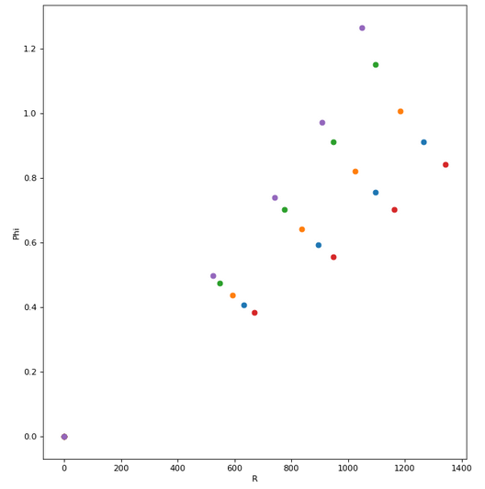
Current work on QHT/QLSA#
Algorithmic Pipeline Design for a toy model with circular tracks.
Optimal Data Encoding and solution for 2n size matrices using QISKit Aqua for HHL sub-routine.
Can we do more with larger sizes? Larger Sizes ≠ More Parallelism.
Post HHL Measurement Result Extraction Sub-routine^{[CLAD13]}.
Quantum Algorithm for Maxima/Minima finding O(√N)^{[CQGW19]}.
Conformal Transform
Toy Model Detector with circular tracks
[CLAD13] Clader, B.D., Jacobs, B.C. and Sprouse, C.R., 2013. Preconditioned quantum linear system algorithm. Physical review letters, 110(25), p.250504.
[CQGW19] An Optimized Quantum Maximum or Minimum Searching Algorithm and its Circuits. https://arxiv.org/abs/1908.07943
# QLSA = Quantum Linear Systems Algorithm

Slide 10
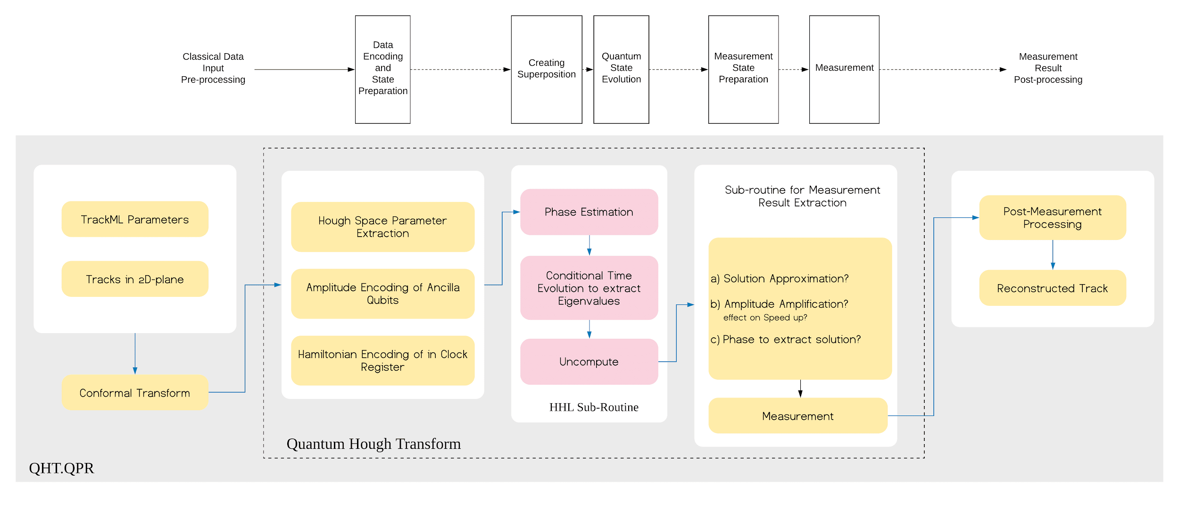
Quantum Hough Transform (using HHL subroutine)

Slide 11
Quantum Hough Transform (using HHL subroutine)

Slide 12
Quantum Hough Transform (using HHL subroutine)

Slide 13
Quantum Hough Transform (using HHL subroutine)

Slide 14
Quantum Hough Transform (using HHL subroutine)

Slide 15
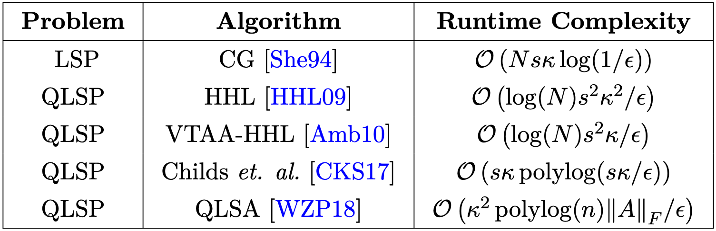
Quantum Hough Transform (using HHL subroutine)
Key Challenges:
|b〉state Encoding
Measurement Result Interpretation (i.e. How to sample exact solutions from |x〉measurement?)

Slide 16
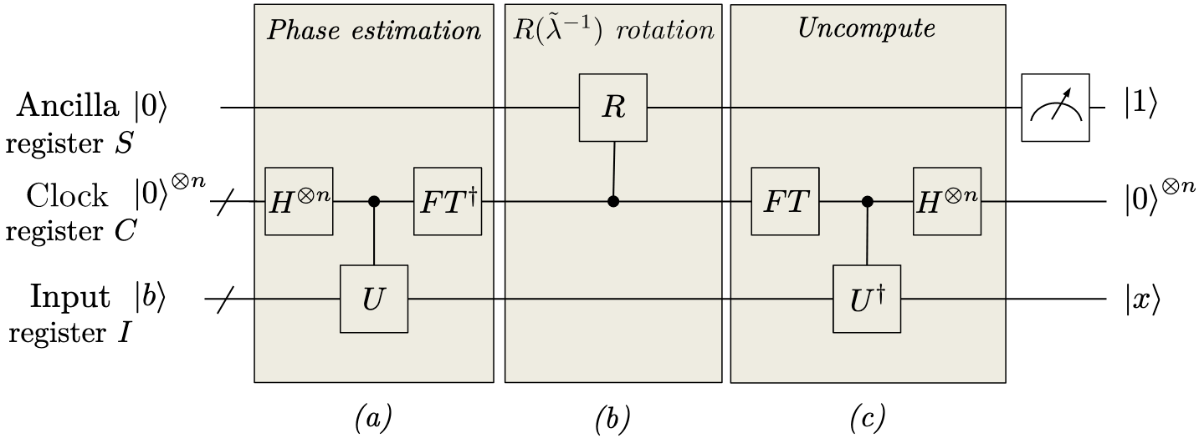
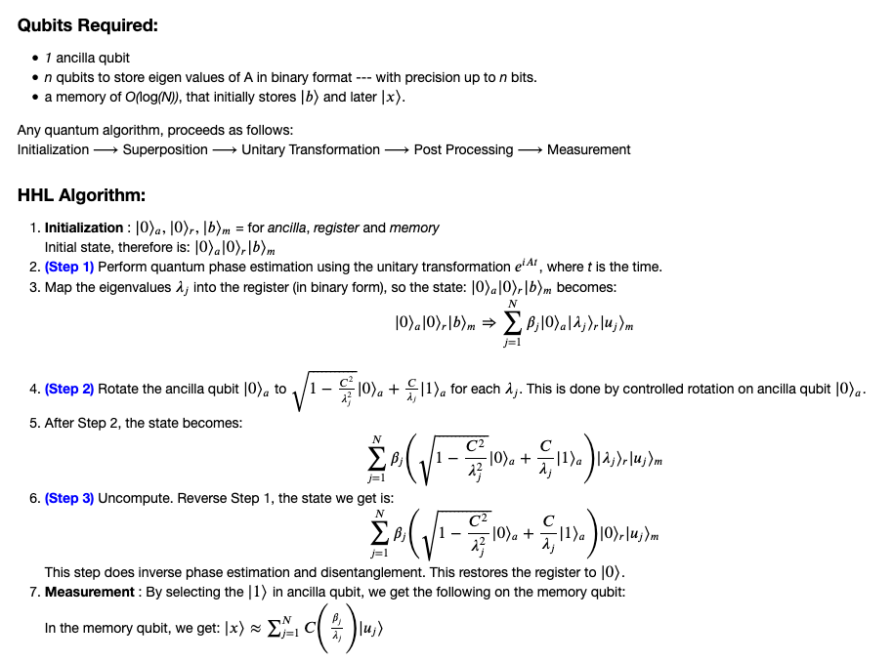
Constructing QHT/QLSA Sub-Routine
The output of the algorithm: Expectation values of Pauli observables of⎪x 〉
Note that, the accuracy of the result depends on the following factors:
Register size
Choice of parameters C and t

Slide 17
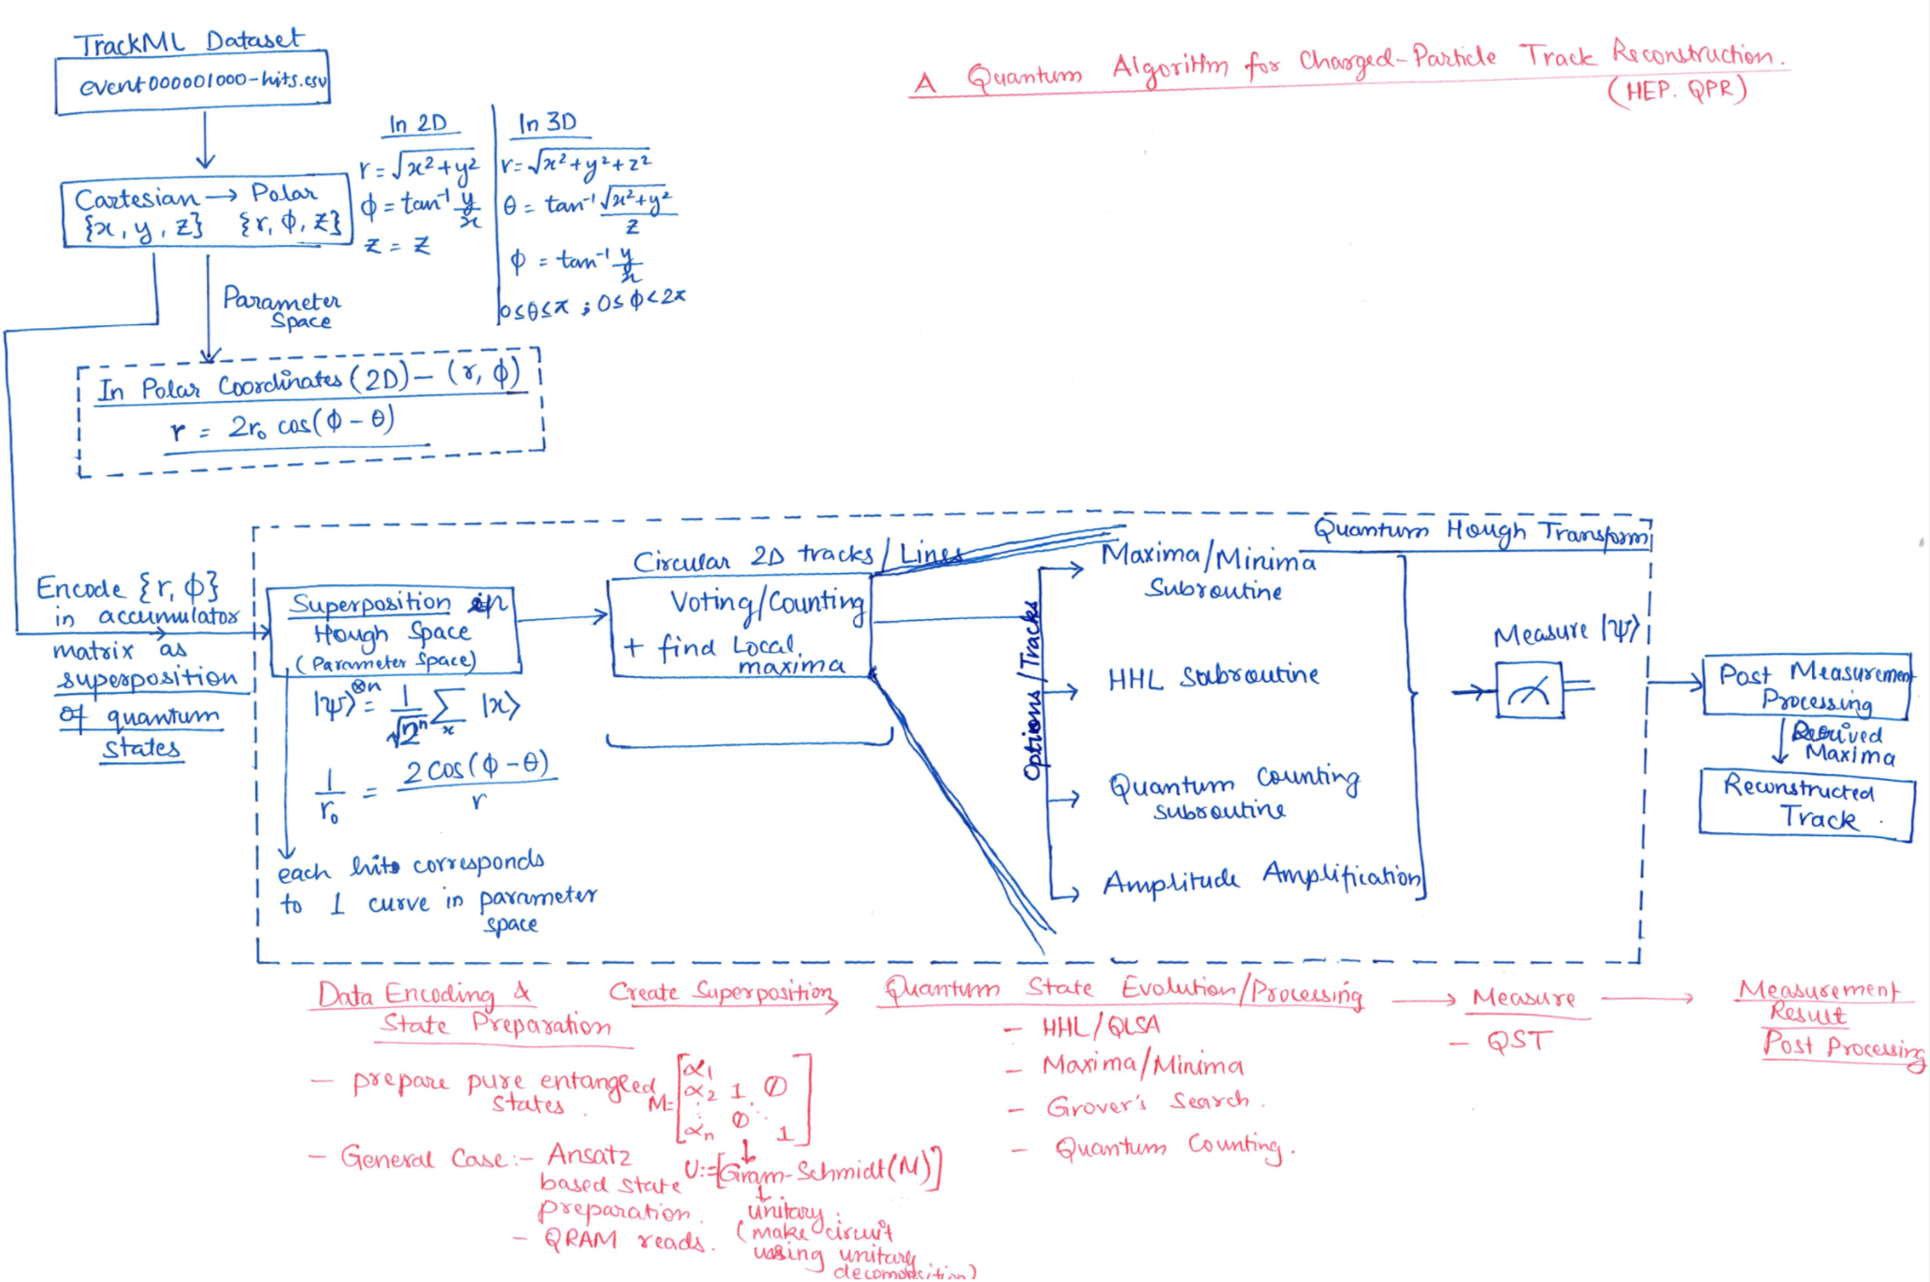

Slide 18
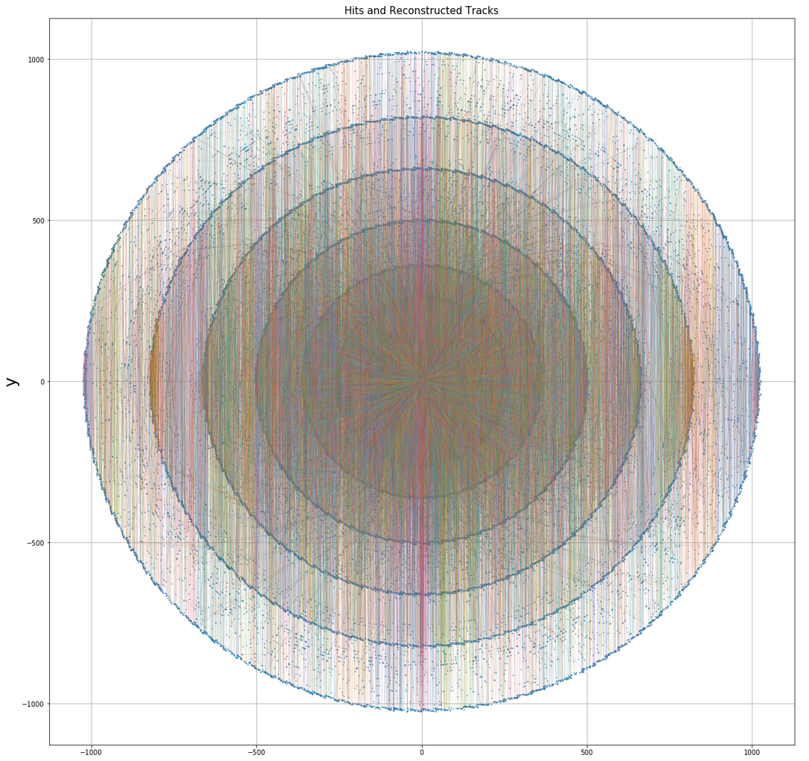
Future Work
Current Work:
Development of quantum hough transform algorithm for toy-model track-reconstruction with dense parameters.
Future Work:
Benchmarking and Precision.
Design for Dense Matrices.
Computational Complexity Analysis.
Evaluation of fault-resilience.
Low Circuit-Depth implementation.
Scaling for large size events.

Slide 19
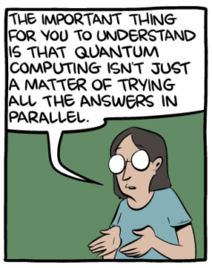
Conclusion
HHL Algorithm for Linear Equation Solver Subroutine for track reconstruction using Hough Transform.
Implementation for 2 x 2, 3 x 3 for low-rank sparse matrices and derivation of matrix sizes to fit 5 parameters of particle tracks.
HL offers guaranteed exponential speed-up for solving linear equations.
Accumulator space formed by Superposition of Qubits.
Algorithmic pipeline design using Quantum Hough Transform using HHL.
QHT.QPR Implementation on NISQ devices.

Slide 20
Modern Quantum Algorithmic Landscape for Gate Model QC (...lots to Explore and Invent!)
Quantum Machine Learning
Bayesian Deep Learning
Quantum Tensor Networks
Quantum Neural Networks
Quantum Principal Component Analysis
Simulation
Variational Quantum Eigensolver (VQEs) and 𝜶-VQEs
QITE/QLanczos
Thermal Averages: METTS Algorithm, Quantum Importance Sampling
Unitary Quantum Dynamics,
Field Theory Simulation, HEP Simulations etc.
Quantum Graph Theory/Other Approaches
Quantum Random Walks
Quantum Monte Carlo
Quantum Probably Approximately Correct
Grover’s Search
Scientific Computing/Mathematical Methods Finite Element Methods, Partial Differential Equations, Poisson Solver
Quantum Linear System Algorithms/HHL
Quantum Support Vector Machine
Quantum Phase Estimation
Quantum Fourier Transform
Optimization
Quantum Alternating Ansatz Algorithms (QAAA) - QAOA and Hamiltonian-based QAOA
Quantum Annealing (on D-Wave)
Quantum-Inspired Classical Algorithms
Recommendation Systems
Notes:
Motivation: First and Second Quantum Revolution (JP Dowling’s Paper)
Present Day applications (Chemistry/Physics Simulation, Optimization, ML...)
Modern Methods used in QC - the landscape

Slide 21
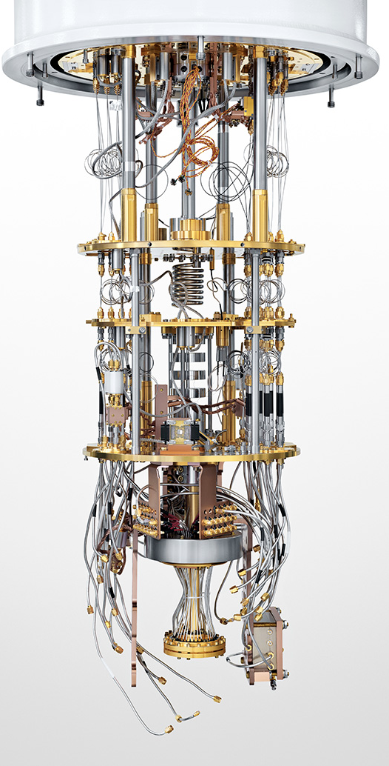


Thank you :)
HEP.QPR Project https://hep-qpr.lbl.gov/
Link to Slides and Project Repository
Weak Quantum Value
Improving solution of any problem, using a QC (possibly in combination with classical methods) so that the results are better than any available purely classical solution
Quantum Advantage
Solution of a valuable problem using a QC, faster or better than any available classical solution
Quantum Supremacy
Mathematical proof that any problem has a super-polynomial separation w.r.t. assumptions (e.g. P ≠ NP) between any possible quantum algorithm and any possible classical algorithm. The exhibition of the solution of this problem by a QC at a performance (size, speed, or efficiency) that is infeasible with any available classical computer.
Quantum Value
improving solution of a valuable problem, using a QC (possibly in combination with classical methods) so that the results are better than any available purely classical solution
Daily dose of Quantum Jargon
Weak Quantum Supremacy
solution of any problem using a QC, faster or better than any available classical solution
Strong Quantum Advantage
Q supremacy + Q advantage (e.g. breaking 2048 RSA with Shor’s algorithm)

Slide 22
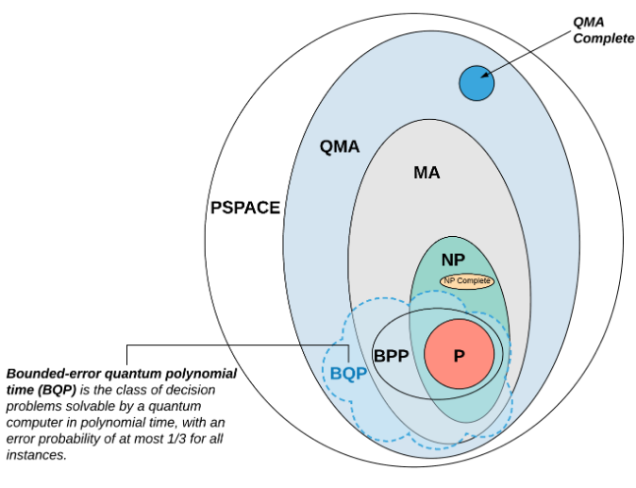
Extra Slides

